Slide 1
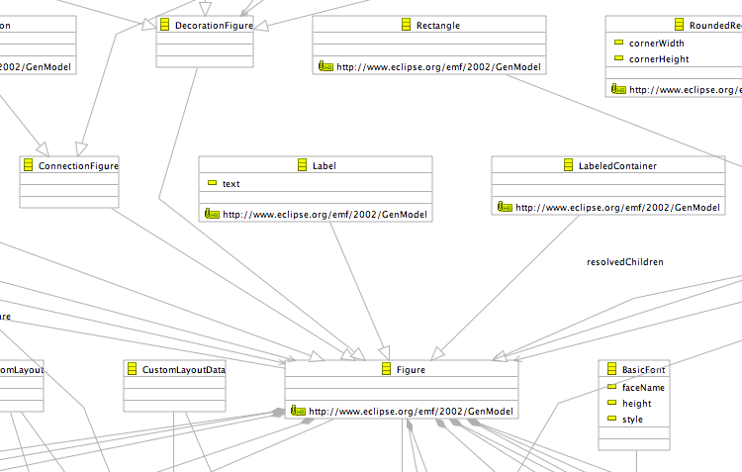
Label in GMF Graphical Definition (Partial)

Slide 2
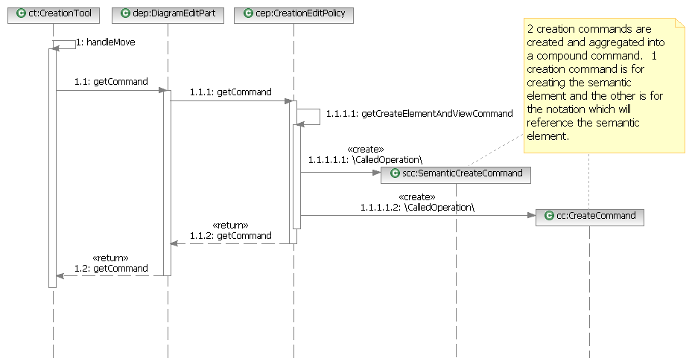
GMF Integration (cont.) (future reference) Canonical Model Element Creation in GMF (Phase I)
(from GMF SDK Help)

Slide 3
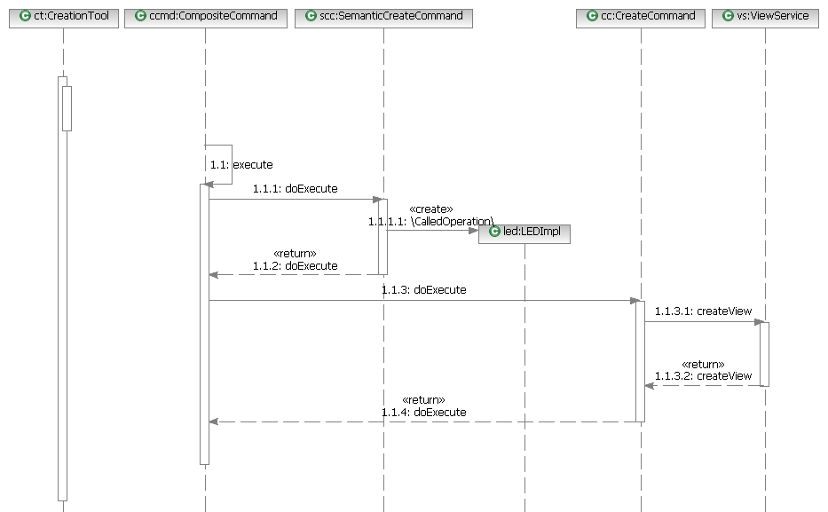
(Phase II)

Slide 4
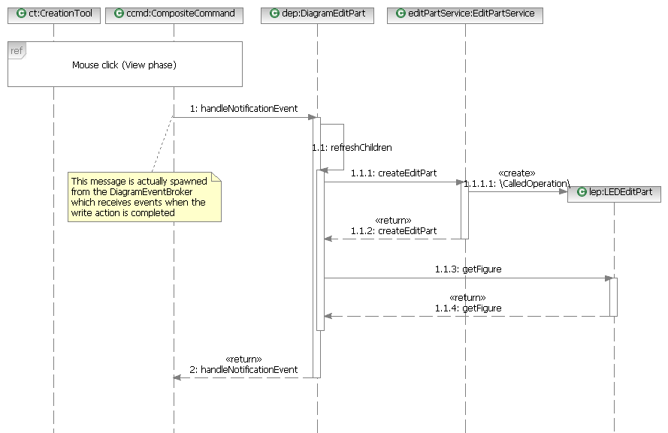
(Phase III)

